Slide 1
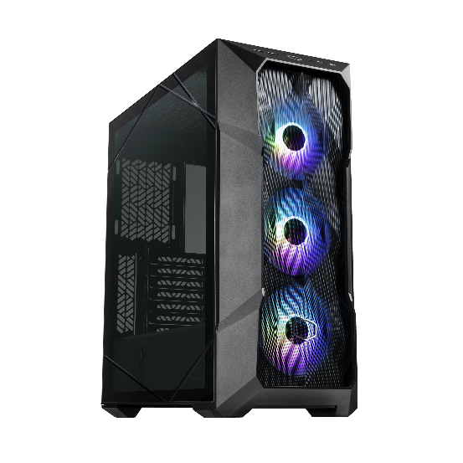
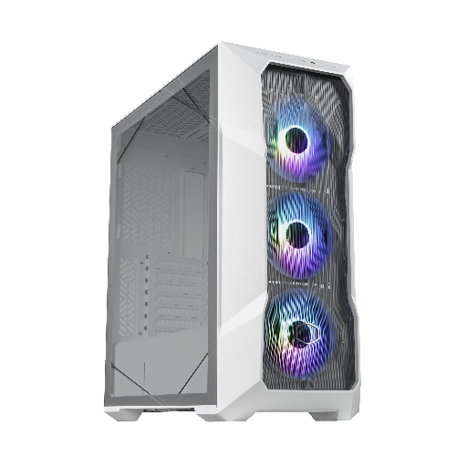
Exquisitely Ruthless
TD500 Mesh V2
TD500V2-KGNN-S00/TD500V2-WGNN-S00
Classic Design Refined
TD500 Mesh V2’s iconic polygonal design paired with included three 120mm ARGB fans engulfs your system in an ever-changing glow, shifting based on the angle viewed to reflect the uniqueness of each gamer’s personality.
Cooler Master’s FineMesh provides the functionality of dust filtration while simultaneously allowing for generous intake and the ultimate experience: smooth running graphics, rapid response rates and blissfully streamlined gaming. Upgraded with USB 3.2 Gen 2 Type C support, TD500 Mesh V2 keep your data transfer at lightning speeds as you power through and play with style.
Product Name |  | TD500 Mesh V2 | TD500 Mesh V2 White
Product Number |  | TD500V2-KGNN-S00 | TD500V2-WGNN-S00
Exterior Color |  | Black | White
Materials | Exterior | Steel, Mesh, Plastic
 | Left Side Panel | Tempered Glass
Dimensions (L x W x H) | incl. Protrusions | 499x210x500mm
 | excl. Protrusions | 430x210x477mm
Motherboard Support |  | Mini-ITX, Micro-ATX, ATX, SSI-CEB, E-ATX* (*up to 12” x 10.7” motherboards, may impact cable management feature)
Expansion Slots |  | 7
Drive Bays | 5.25“ ODD | N/A
 | 3.5” HDD | 2
 | 2.5” SSD | 3
I/O Panel | USB Ports | 2 x USB 3.2 Gen 1 + 1x USB3.2 Gen 2 type C
 | Audio | Audio jack x1
 | Other | 1 x ARGB fan Hub
Pre-installed Fan(s) | Top | N/A
 | Front | 3 x 120mm CF120 ARGB
 | Rear | N/A
Fan Support | Top | 3 x 120mm 2 x 140mm
 | Front | 3 x 120mm 2 x 140mm
 | Rear | 1 x 120mm
Radiator Support | Top | 120/140/240/280/360mm (recommended maximum thickness - 55mm）
 | Front | 120 / 140 / 240 / 280 / 360mm
 | Rear | 120mm
Clearances | CPU Cooler | 165mm / 6.49”
 | Power Supply | 200mm (Recommended up to 170mm)
 | Graphics Card | 410mm / 16.14”
Cable Routing | Behind MB Tray | 19mm / 0.74”
Dust Filters |  | Front, Top, Bottom
Power Supply Support |  | Bottom Mount, ATX
Warranty |  | 2 Years
Polygonal Mesh – Crafted from Cooler Master’s Fine Mesh technology, Polygonal Mesh features a three-dimensional contour and is also capable of simultaneously providing high airflow and dust filtration.
Triple ARGB Fans – Three addressable RGB fans flood the Polygonal Mesh front panel with lighting while providing considerable airflow to the system.
USB 3.2 Gen 2 Type C Support – USB 3.2 Gen 2 Type C port built into the I/O panel allows multi-purpose, streamlined data transmission.
Versatile Cooling Options – Support for up to seven 120mm fans and 360mm front and top radiator support ensure that performance is not compromised.
Tool-Free Crystalline TG Side Panel – A crystalline design spans the edges of the tempered glass side panel, completely toolless for quick access to the internals. An optional screw can be installed to further secure the tempered glass side panel.
PSU Shroud With Removable Cover-
TD500 Mesh V2’s removable PSU cover allows users to freely showcase unique PSU designs or keep PSUs hidden for a stealthier aesthetic. When not in use, the PSU cover can be stored on the motherboard tray for easy safekeeping.
Removable Top Panel – The top panel is entirely removable for improved access to the components during assembly. Ease of use also facilitates the mounting of cooling solutions such as fans and radiators.
P/N | TD500V2-KGNN-S00 | TD500V2-WGNN-S00
EAN | 4719512135365 | 4719512135358
UPC | 884102107689 | 884102107672
Net weight | 7.7kg | 7.7kg
Gross weight | 9.2kg | 9.2kg
Carton dimension (L x W x H) | 558x290x584mm | 558x290x584mm
Cont. | W/ Pallet | Carton/ Pallet | W/O Pallet
20’ | 280 | 28 | 336
40’ | 560 | 28 | 672
40 HQ | 640 | 32 | 756

Slide 2
Feature Highlights
140mm
140mm
120mm
120mm
120mm
120mm
120mm
140mm
120mm
140mm
120mm
Polygonal Mesh
USB 3.2 Gen 2 Type C Support
Versatile Cooling Options
Polygonal FineMesh features a three-dimensional contour and is also capable of simultaneously providing high airflow and dust filtration.
USB 3.2 Gen 2 Type C port built into the I/O panel allows multi-purpose, streamlined data transmission.
Support for up to seven 120mm fans and 360mm front and top radiator support ensure that performance is not compromised.
Tool-Free Crystalline TG Side Panel
PSU Shroud With Removable Cover
Removable Top Panel
A crystalline design spans the edges of the tempered glass side panel, completely toolless for quick access to the internals. An optional screw can be installed to further secure the tempered glass side panel.
TD500 Mesh V2’s removable PSU cover allows users to freely showcase unique PSU designs or keep PSUs hidden for a stealthier aesthetic. When not in use, the PSU cover can be stored on the motherboard tray for easy safekeeping.
The top panel is entirely removable for improved access to the components during assembly. Ease of use also facilitates the mounting of cooling solutions such as fans and radiators.

